Slide 1
SOCIAL MEDIA ANALYTICS
Sports Betting
Influence Network
Analysis
Mapping opinion leaders, community structure & the homophily vs. social influence question
Abhay Puri
Ethan Davenport
John MacDonald
Carter St. Geme
Liam Thompson
Grant Treadaway
Data: Covers.com Forum · Network Analysis

Slide 2
AGENDA
What We'll Cover
01
Problem Statement
02
Data & Network Construction
Why post volume doesn't tell the full story
Covers.com forum → directed interaction graph
03
Network Structure
04
Centrality Analysis
Density, components, degree distribution
All four metrics — and why they diverge
05
Community Detection
06
GraphRAG Content Analysis
Louvain clustering & organic bettor groups
Querying post content with AI + knowledge graph
07
Homophily vs. Influence
08
Key Findings & Business Value
Are clusters self-selected or shaped by influencers?
Who really drives opinion in sports betting

Slide 3
01 · PROBLEM STATEMENT
The Follower Count Fallacy
9,841
Sports betting forums on Covers.com are large and highly active — but raw post volume and follower count don't reveal who actually shapes opinion.
Total Forum Posts
The Real Question
NFL · MLB · NHL
Network analytics can identify true influencers and answer whether bettor clusters form because users influence each other — or because like-minded people were already drawn together.
Sports Covered
~30%
Posts With Quote/Reply
💡 We want to find the real influencers — not just the loudest voices.

Slide 4
02 · DATA & NETWORK CONSTRUCTION
From Forum Posts to Network Graph
📥
Raw Data
🔗
Edge List
🕸️
Network
Covers.com forum posts sport · poster · quoted_user 9,841 rows
→
poster → quoted_user when has_quote = True Weighted by frequency
→
Directed, weighted DiGraph Nodes = users Edges = reply interactions
Network Properties
"
Covers.com is one of the largest online sports betting communities. Quote-replies reveal exactly who each user is engaging with — a clean proxy for directed attention.
Nodes (users)
Unique forum participants
Edges (directed)
Quote / reply interactions
Edge weight
Interaction frequency between pair
Self-loops
Removed — can't quote yourself
— Data Source Rationale

Slide 5
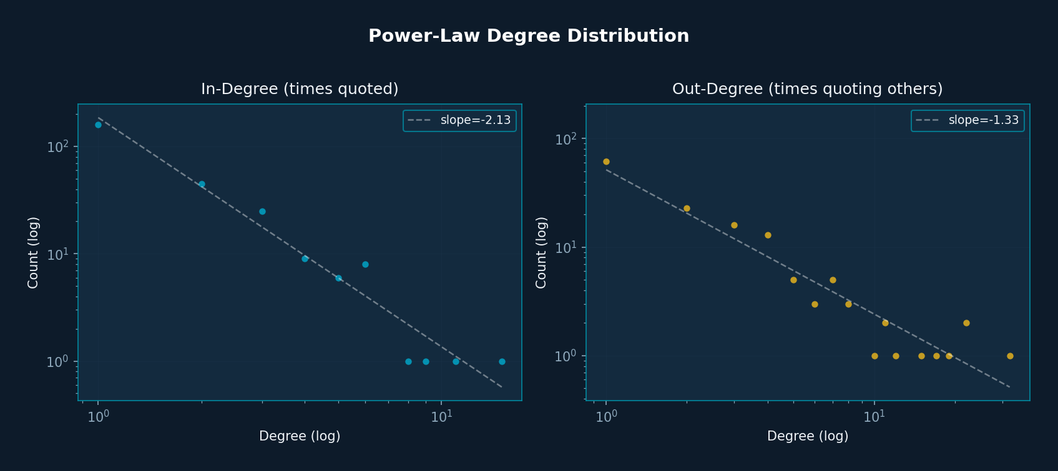
03 · NETWORK STRUCTURE
Power-Law Distribution — A Real Social Network
296
481
0.0055
0.623
Users (nodes)
Interactions (edges)
Network Density
Modularity Score

Slide 6
04 · CENTRALITY ANALYSIS
Four Metrics. Four Different Stories.
1
Degree
2
Betweenness
Who is most active?
Who bridges clusters?
Counts direct connections — identifies the most popular/prolific users.
How often a user sits on shortest paths — the hidden bridge metric.
3
Closeness
4
PageRank
Who spreads info fastest?
Who do important users engage with?
How quickly a user can reach everyone else in the network.
Google-style: high score = other high-score users reply to you.
🔑 Key Question: Are the top-volume users the same as top-PageRank users? → See next slide.

Slide 7
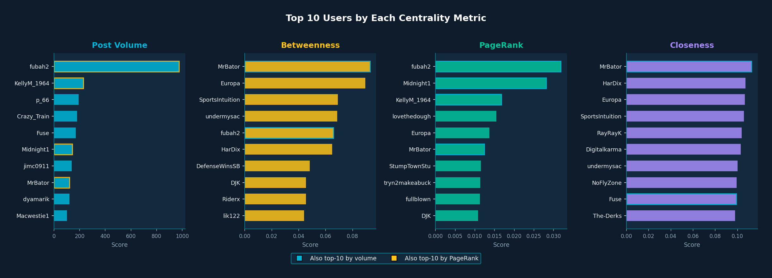
04 · CENTRALITY ANALYSIS — RANKINGS
Who Appears in Which Lists?
🔑 A-Ha: MrBator leads Betweenness but doesn't appear in Post Volume — a true bridge account invisible to surface metrics.
Spearman r (Volume vs Betweenness) = 0.507
Spearman r (Volume vs PageRank) = 0.416

Slide 8
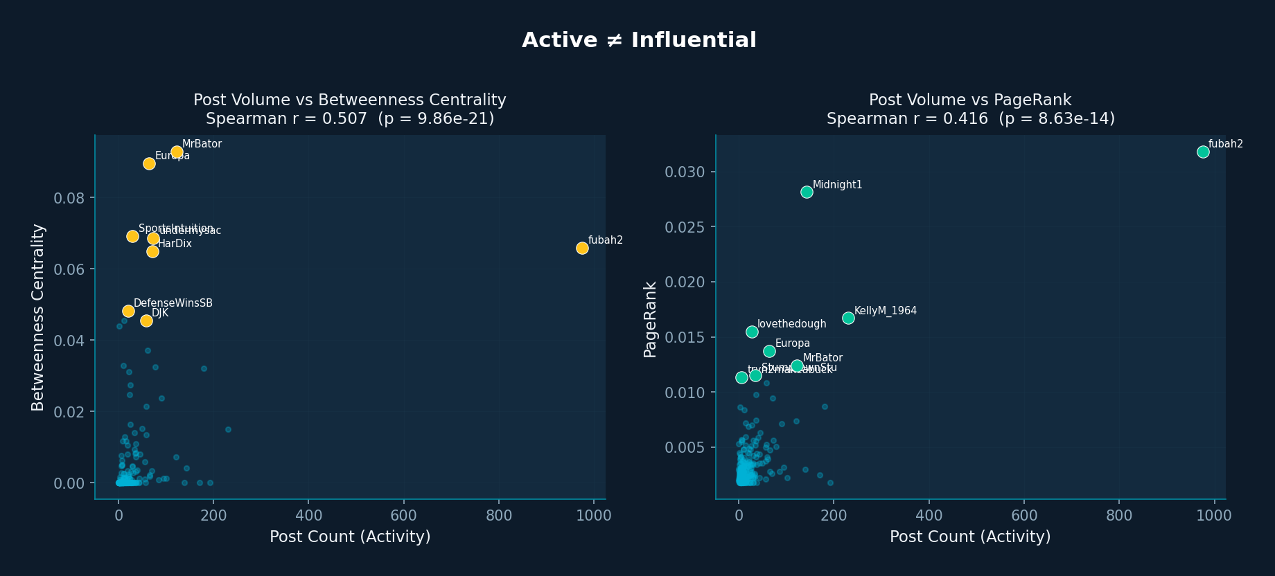
04 · CENTRALITY ANALYSIS — ACTIVE ≠ INFLUENTIAL
Post Volume vs. True Influence
🔑 Scattered points = weak correlation. Red dots = truly influential users. Most don't have extreme post counts.

Slide 9
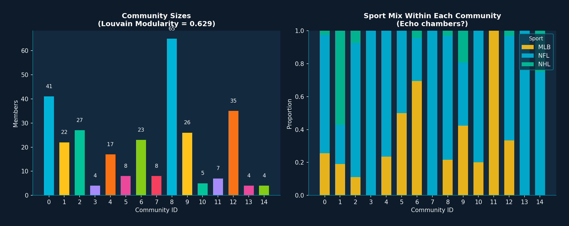
05 · COMMUNITY DETECTION
12 Organic Communities — Modularity 0.623
🔑 Modularity 0.623 is very strong. Sport-based echo chambers visible — NFL, MLB, NHL users cluster separately.
12 communities · 77.5% of edges within-community · Louvain on undirected projection

Slide 10
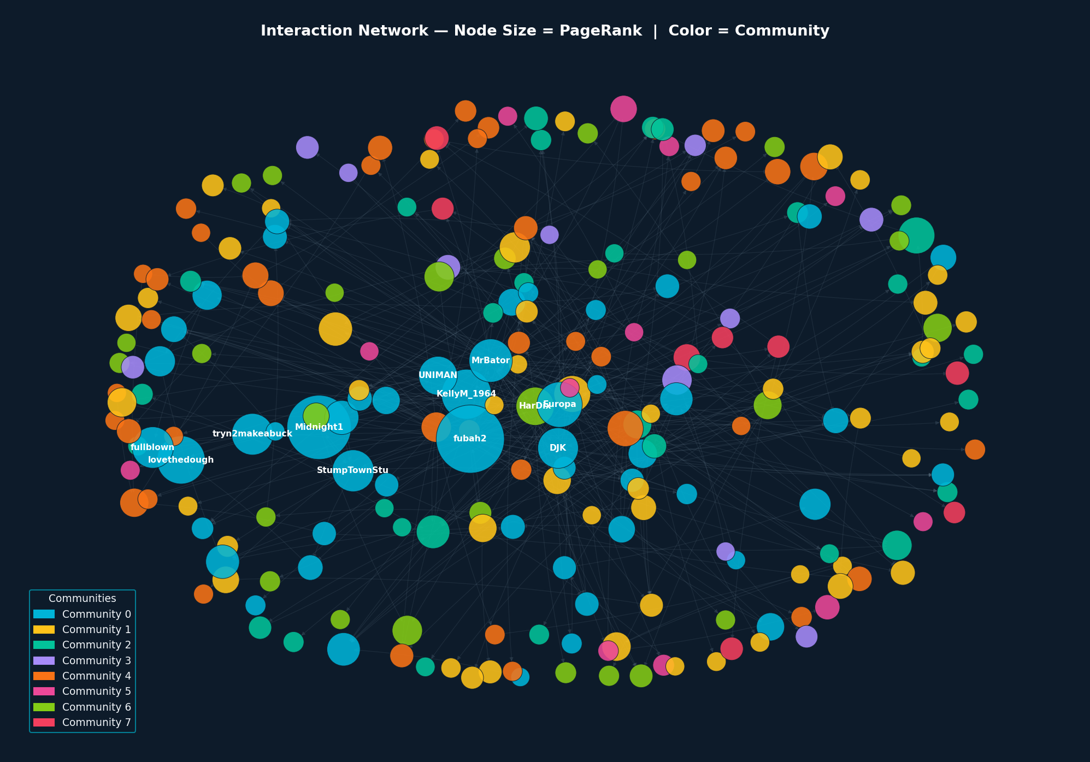
05 · COMMUNITY DETECTION — NETWORK MAP
The Influence Network, Colored by Community
Node size = PageRank · Color = Community · Labels = top-12 by PageRank · Edges = quote-replies

Slide 11
06 · GRAPHRAG CONTENT ANALYSIS
What Are Bettors Actually Talking About?
How GraphRAG Works
Example Queries on Our Data
①
Load & Prepare
Q: What are the main NFL themes?
CSV posts → unique IDs, cleaned text
A: Betting trends, team support dynamics, and confirmation bias — sharp bettors seeking validation for their picks.
②
Neo4j Knowledge Graph
User, Post, Sport nodes + WROTE / QUOTES / IN_SPORT edges
Q: Who is driving the sharp vs. casual divide?
A: Users like pattomlinson and DJK anchor sharp-side discussion; casual fan threads cluster around team loyalty.
③
Vector Index
OpenAI embeddings on every post — semantic similarity search
Q: Is sharp betting discussed in other sports?
④
Query Pipeline
Vector search + graph traversal + conversation history → GPT-4o-mini
A: Insufficient evidence — the dataset is NFL-dominant for analytical betting content.
🔑 GraphRAG bridges the content layer and the network layer — confirming sharp vs. casual clusters structurally AND semantically.

Slide 12
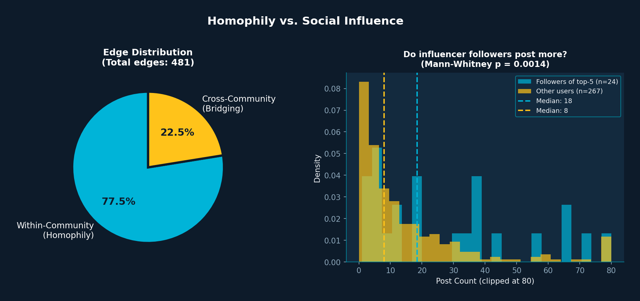
07 · HOMOPHILY VS. SOCIAL INFLUENCE
Why Do Bettors Cluster? The Data Answers.
🔑 77.5% within-community edges → homophily dominates. Followers of top-5 influencers ARE significantly more active (p=0.0014).

Slide 13
08 · KEY FINDINGS & BUSINESS VALUE
So What Does This Tell Us?
🎯
Active ≠ Influential
Business Value
MrBator leads betweenness but barely cracks the post-volume top-10. Bridge accounts drive cross-community flow invisibly.
🏦
Sportsbooks
Network-based influencer scores for targeted sentiment campaigns
🏘️
Strong Community Isolation
Modularity 0.623 and 77.5% within-community edges confirm sharp and casual bettors are far more separated than the forum appears.
📺
Sports Media
Identify who moves public betting sentiment, not just who posts most
🧲
Homophily Dominates, But Influence Exists
Users self-select by sport & style, but followers of top-PageRank users are significantly more active (p=0.0014). Both forces present.
🔍
Integrity
Tout scammers: high out-degree, low betweenness — flaggable pattern

Slide 14
Thank You
Questions?
Abhay Puri · John MacDonald · Liam Thompson
Ethan Davenport · Carter St. Geme · Grant Treadaway
Social Media Analytics · Sports Betting Influence Network Analysis
Data: Covers.com forum · Tools: Python · NetworkX · Louvain · Neo4j · GraphRAG

